Slide 1
AJAX WITH JAVASCRIPT
Techniques for Asynchronous Web Communication
Notes:
Copyright © Terry Felke-Morris

Slide 2
What is AJAX?
Multiple meanings:
Greek mythological hero – Ajax the Great
Computing/web development
Town (Canada), Greek Play, floating crane
Not a technology or language, but a combination of technologies – Asynchronous JavaScript and XML (AJAX)
Set of techniques for creating interactive web apps where data can be retrieved (From server) without refereshing.
Enables communication between client-side (JavaScript) and server-side
Key features:
Send HTTP requests in the background
Receive responses without page reloads
Update page fragments dynamically (with the data from response)

Slide 3
Benefits of AJAX
No page reloads or redirects
Load only fragments of a page (not entire HTML page)
Add dynamic capabilities:
Fetch data from files
Connect to scripts pulling from databases

Slide 4
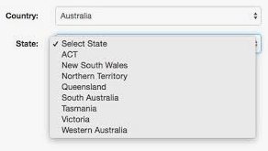
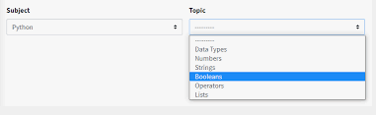
Benefits of AJAX
Continent → Country
Country → State/City
Subject → Topic
Category → Subcategory

Slide 5
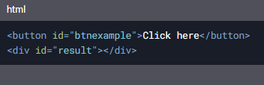
Setup for AJAX Demos
Files needed:
index.html: Full HTML page with a button and a div element
content.html: Fragment (e.g. <h1>Heading</h1>)
Only a heading is present in this page – no html structure
Prerequisite: Install the “Live Server” plugin for VSCode

Slide 6
Sending HTTP Requests
Two Approaches:
XMLHttpRequest object (Traditional/ Vanilla JavaScript)
No need to install any additional framework
Fetch API (Modern, ES6+)

Slide 7
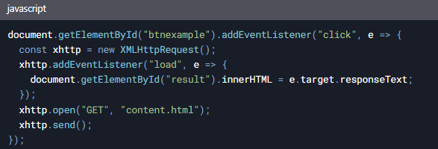
XMLHttpRequest Example
Steps:
Create an XMLHttpRequest object
Set up a load event listener
Open and send the request

Slide 8
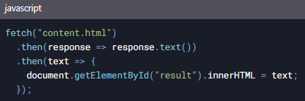
Fetch API Example
Uses Promises for cleaner syntax
Steps:
Call fetch()
Convert response to text
Update the DOM

Slide 9
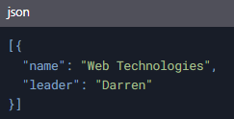
Working with JSON
JSON: Universal data format (similar to Python dictionaries)
Example modules.json:
Parsing required to convert JSON to usable data

Slide 10
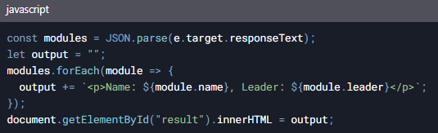
JSON with XMLHttpRequest
Use JSON.parse() to decode the response:

Slide 11
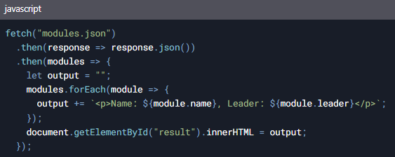
JSON with Fetch API
Call .json() instead of .text():

Slide 12
Summary
AJAX enables asynchronous, dynamic web updates
XMLHttpRequest: Traditional, verbose
Fetch API: Modern, promise-based
JSON is the standard for data exchange

